Slide 1

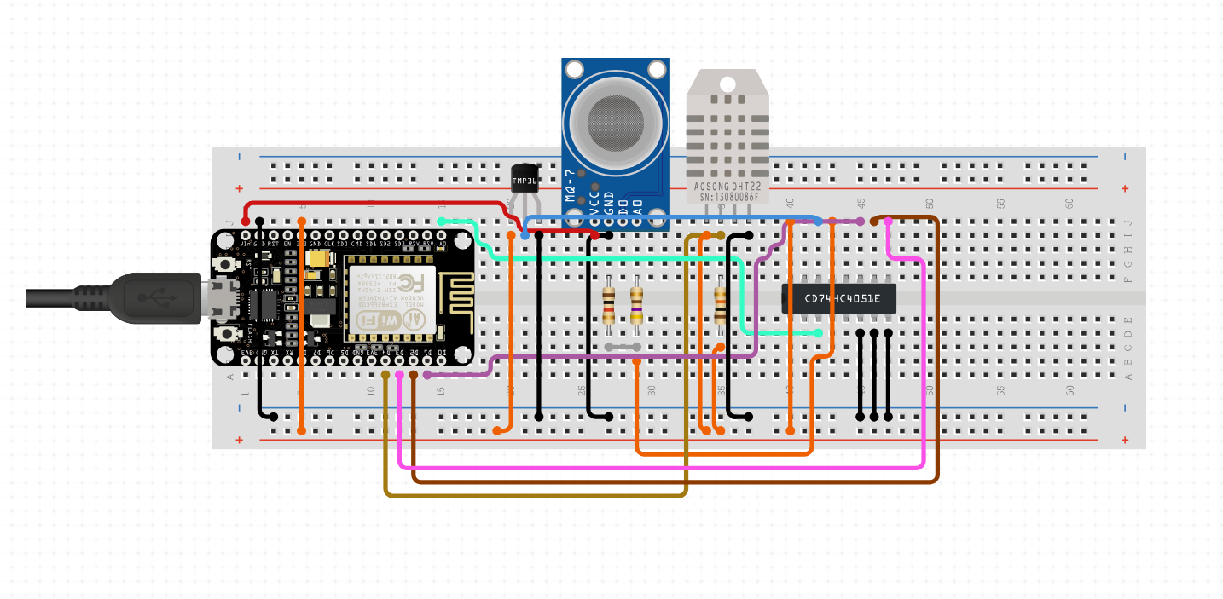
Smart Compost Monitoring System

Slide 2
Team Members
1. Ujjwal Aggarwal(Team Leader)
2200290140167
2. Sparsh Goel
2200290140154
Project Supervisor
Dr. Ankit Verma

Slide 3
Introduction
Today, we delve into the realm of composting, an essential practice for sustainable waste management, and explore how IoT, or the Internet of Things, is revolutionizing this age-old process. Composting has traditionally relied on manual observation, but with IoT technology, we now have the capability to monitor key parameters such as temperature, moisture, Carbon to Nitrogen ratios in real-time. This presentation will highlight the benefits and functionalities of smart compost monitoring systems based on IoT, showcasing their potential to optimize composting processes, minimize resource wastage, and contribute to a greener, more sustainable future.

Slide 4
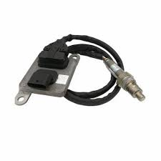
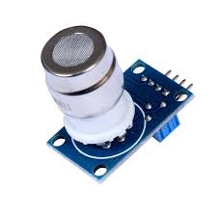
Software Components
Embedded Software:
  Microcontroller firmware must be developed to facilitate data acquisition from sensors, data processing, and communication protocols.
Data Processing and Analysis Software:
  Software algorithms are necessary to interpret sensor data, analyze trends, and derive actionable insights regarding composting conditions.
Cloud-Based Platforms or Databases:
  Cloud infrastructure is required for storing and accessing collected data, enabling remote monitoring and analysis of composting processes.
User Interface Software:
  Intuitive interfaces, whether through mobile applications or web-based dashboards, are essential for users to visualize real-time data, configure system parameters, and receive alerts or notifications.

Slide 5
Hardware Components
IoT Sensors:
  Temperature sensors: To monitor the temperature of the composting pile, enabling detection of optimal temperature ranges for microbial activity.
  Humidity sensors: Essential for assessing moisture levels within the compost, aiding in maintaining the ideal moisture content.
  pH sensors: Necessary for monitoring the acidity or alkalinity of the compost, ensuring optimal conditions for decomposition.
  Carbon dioxide senor: To gauge Carbon Dioxide levels within the composting environment, crucial for aerobic decomposition processes.
  Nitrogen sensor: To gauge the Realtime nitrogen emission when the compost is added.
Microcontrollers or Single Board Computers (SBCs):
  Arduino, Raspberry Pi, or similar platforms are required to interface with sensors, process data, and facilitate communication with the central processing unit.
Wireless Communication Modules:
  Wi-Fi, Bluetooth, or Zigbee modules enable wireless transmission of sensor data to the central processing unit, ensuring real-time monitoring capabilities.
Power Supply:
  Reliable power sources, such as batteries or solar panels, are essential to ensure uninterrupted operation of the hardware components.

Slide 6
Modules Description
Temperature Sensor Module:
  Description: A temperature sensor module is used to measure the temperature of the composting pile. It typically consists of a temperature sensor (e.g., thermistor or digital temperature sensor) and associated circuitry for signal conditioning.
  Functionality: The temperature sensor module detects changes in temperature within the compost, providing data for monitoring the composting process and ensuring optimal conditions for decomposition.
Humidity Sensor Module:
  Description: A humidity sensor module measures the moisture content of the compost. It usually contains a capacitive or resistive humidity sensor along with supporting components for signal processing.
  Functionality: The humidity sensor module monitors moisture levels in the compost, helping to prevent over-drying or excessive moisture, which can impact microbial activity and compost quality.

Slide 7
3. pH Sensor Module:
  Description: A pH sensor module is employed to measure the acidity or alkalinity of the compost. It typically includes a pH electrode or pH probe and associated circuitry for accurate pH measurement.
  Functionality: The pH sensor module assesses the pH level of the compost, ensuring it remains within the optimal range for microbial activity and decomposition processes.
4. Carbon Dioxide Sensor Module:
  Description: A Carbon Dioxide sensor module detects Carbon Dioxide levels within the composting environment. It may utilize electrochemical or optical sensors to measure Carbon Dioxide concentration.
  Functionality: The Carbon Dioxide sensor module provides data on Carbon Dioxide levels in the compost, indicating whether aerobic decomposition processes are occurring efficiently. This information helps optimize composting conditions.
5. Microcontroller Module:
  Description: A microcontroller module serves as the brain of the system, interfacing with sensors, processing data, and controlling system operation. Common microcontrollers include Arduino boards or Raspberry Pi single board computers (SBCs).
  Functionality: The microcontroller module reads data from sensors, performs data processing tasks, and communicates with the central processing unit or cloud platform. It may also execute control algorithms to adjust composting conditions based on sensor readings.

Slide 8
6. Wireless Communication Module:
Description: A wireless communication module enables wireless data transmission from sensors to the central processing unit or cloud platform. It may utilize Wi-Fi, Bluetooth, Zigbee, or other wireless protocols.
Functionality: The wireless communication module facilitates real-time data transfer, allowing remote monitoring and control of the composting system. It ensures seamless connectivity between sensors and the central processing unit.

Slide 9
Reports
Real-Time Sensor Data:
  Temperature: Continuous monitoring of compost temperature over time, displayed in graphical or tabular format.
  Humidity: Real-time measurement of compost moisture levels, indicating variations in moisture content.
  pH Levels: Instantaneous pH readings of the compost, highlighting any fluctuations in acidity or alkalinity.
  Carbon Dioxide Levels: Live data on Carbon Dioxide concentration within the composting environment, reflecting aerobic decomposition activity.
Trend Analysis:
  Temperature Trends: Analysis of temperature trends over time, identifying patterns and deviations from optimal temperature ranges for composting.
  Moisture Trends: Trend analysis of compost moisture levels, revealing long-term moisture trends and potential drying or wetting trends.
  pH Trends: Trend analysis of pH levels in the compost, indicating changes in acidity or alkalinity over time.
  Carbon Dioxide Trends: Examination of Carbon Dioxide concentration trends, showing variations in aerobic decomposition activity.

Slide 10
3. Alerts and Notifications:
  Temperature Alerts: Automatic alerts triggered when compost temperature exceeds or falls below predefined thresholds, indicating potential issues with microbial activity.
  Moisture Alerts: Notifications sent when compost moisture levels deviate from the desired range, signaling the need for adjustments to maintain optimal moisture content.
  pH Alerts: Alerts generated in response to significant changes in compost pH, prompting corrective measures to prevent adverse effects on microbial activity.
  Carbon Dioxide Alerts: Notifications issued when Carbon Dioxide levels in the composting environment drop below optimal levels, indicating potential anaerobic conditions.
4. Composting Performance Metrics:
  Compost Quality Metrics: Quantitative assessment of compost quality parameters such as maturity, stability, and nutrient content based on sensor data.
  Composting Efficiency Metrics: Evaluation of composting process efficiency, including decomposition rates, time to maturity, and resource utilization efficiency.
  Environmental Impact Assessment: Analysis of environmental factors such as greenhouse gas emissions and nutrient leaching, aiding in the assessment of composting sustainability.
5. Data Visualization and Dashboards:
  Graphical Representations: Visualizations such as line charts, bar graphs, and scatter plots to illustrate sensor data trends and patterns.
  Dashboard Interface: User-friendly dashboards providing a comprehensive overview of composting parameters, alerts, and system status in real-time.
  Interactive Features: Interactive elements allowing users to customize data displays, set thresholds, and access historical data for further analysis.

Slide 11
Conclusion
Smart compost monitoring systems using IoT technology offer real-time monitoring of composting parameters, enabling informed decision-making and optimization of composting processes. By integrating sensors, microcontrollers, and wireless communication, these systems provide valuable insights, alerts, and visualizations to enhance compost quality, efficiency, and sustainability. With their ability to track trends, prevent issues, and promote data-driven decision-making, smart compost monitoring systems are poised to revolutionize composting practices and contribute to a more sustainable future.

Slide 12
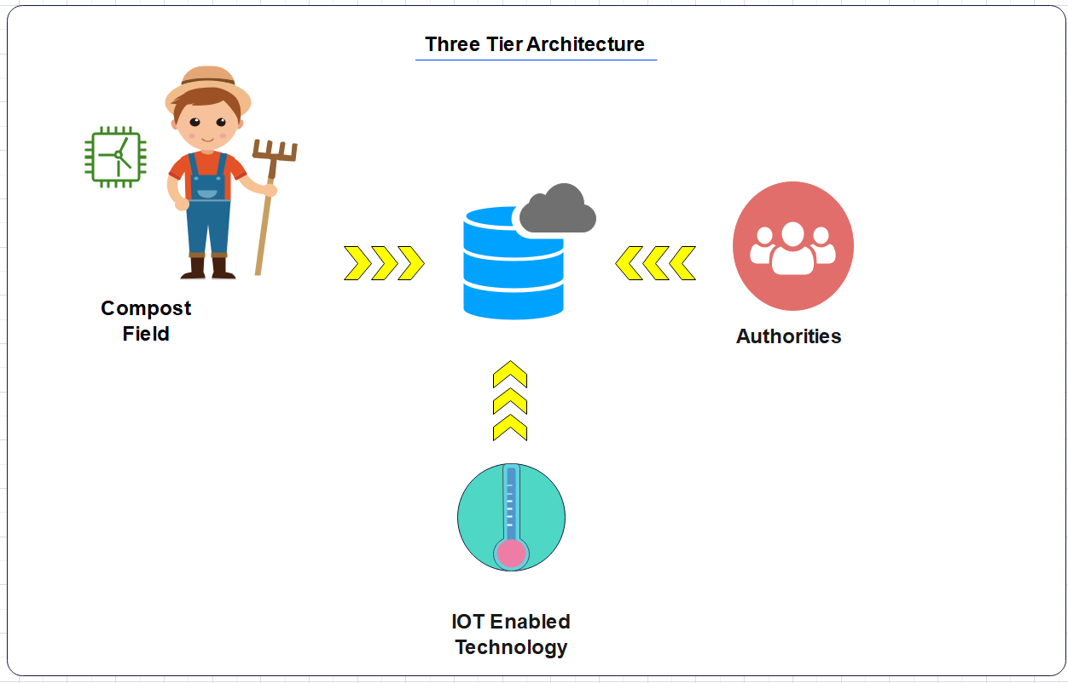
How to Serve the Society
Serving society involves identifying needs, leveraging one's skills and resources to address those needs, and making a positive impact on individuals and communities. This can be achieved through volunteering, charitable contributions, advocacy, mentorship, or simply acts of kindness and compassion. By actively engaging in initiatives that promote social welfare, equity, and justice, individuals can contribute to building a more inclusive, supportive, and thriving society for all.

